Slide 1


Jan
01
2011
Sapient Global Markets | Geneva Solutions
Spotlights 2010
Java - 101
JUnit

Slide 2
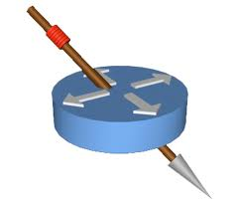
Objectives
Understand the need of writing automated Unit tests.
Learn to write test cases using JUnit.
Understand how JUnit works.
Apply the understanding of JUnit for unit testing.

Slide 3
Pre-requisites
Following software should be pre-installed on local workstations:
  Minimum JDK 1.5 required
  Eclipse
Set up required:
  Add JAVA_HOME to your environment and the “bin” directory to your PATH

Slide 4

Testing Basics

Slide 5
Testing
Testing is conducted to compare the product behavior against specification or requirements.
Testing is a comparison between :
  Expected behavior of the component, and
  Actual behavior of the component
The challenge in testing is to efficiently cover the state space.
Testing helps increase our confidence in our code
Test Driven Development (TDD)
  Write tests first!
Notes:
Jmeter is used for stress/load testing

Slide 6
Types of Testing
  Unit Testing
    Testing of individual modules
  Integration Testing
    Testing of integrated modules to verify combined functionality after integration
  Functional Testing
    Ignore the internal parts and focus on testing if the output is as per requirement or not
  System Testing
    Entire system is tested as per the requirements.
  User Acceptance Testing
    Verify if the system meets the customer specified requirements.

Slide 7
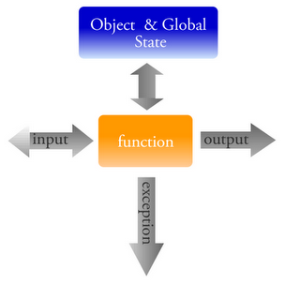
Unit Testing
Unit testing is performed by developer at class/method level during development phase of SDLC.
It is white box testing.
The methods of a java class are tested by passing arguments.
The return value of the method is checked against the expected value.

Slide 8
Test?
Test is a verb meaning “to evaluate”.
Test (Noun):
Test is also a noun, “a procedure leading to acceptance or rejection”.
Is Test the noun different from Test the verb?

Slide 9
Exercise
Write a Calculator program with methods for the following operations:
  Add
  Subtract
  Multiply
  Divide
Test all Calculator methods from a test class (using main)

Slide 10
Need for a Unit Testing Framework
Problems with conventional ways of unit testing:
  Printing to standard output to manually check the result.
  Write if-else condition to check whether expected out put is received.
  Watch the screen carefully for the error message if the code fails. Not a user friendly way to find the failure.
  Use of try/catch blocks for testing the failure.
  As an application gets more complicated and tests more involved, continuing to build and maintain the test code becomes a burden.
What do we need?
  A unit testing framework to avoid the above problems.

Slide 11
Unit Test Frameworks - Best Practices
Best practices for Unit testing frameworks:
Each unit test should run independently of all other unit tests.
The framework should detect and report errors test by test.
It should be easy to define which unit tests will run.
Unit testing should be fully automated, requiring no human intervention.

Slide 12
Benefit of Unit Tests
Allow greater test coverage than functional tests
Increase team productivity
Detect regressions and limit the need for debugging
Give us the confidence to refactor and, in general, make changes
Improve implementation
Document expected behavior
Enable code coverage and other metrics

Slide 13
JUnit

Slide 14
Video Tutorials
Junit | How to Write Junit Test Cases | This is an eclipse video that demonstrates how to write simple Junit test cases. | GMI | Java Video Series | Junit Test Cases
Junit | Testing an Exception | This is an eclipse video that demonstrates how to test an exception in Junit. | GMI | Java Video Series | Testing an Exception in Junit
Junit | Test Fixtures | This is an eclipse video that demonstrates the usage of Junit Test Fixtures. | GMI | Java Video Series | Junit - Test Fixtures Annotations
TDD | How to do Test Driven Development | This eclipse video talks about how to do TDD. | https://vox.sapient.com/videos/7662
Junit | Stubs and Mock - Part I | This video talks about basics of Stubs and Mocks | GMI | Java Video Series | Junit - Stubs and Mock - Part I
Junit | Stubs and Mock - Part 2 | This video talk about basics of Mocks in Junit. | GMI | Java Video Series | Junit - Stubs and Mocks - Part II
Junit | Mocking with Mockito | This is an eclipse video that demonstrates how to mock an object using Mockito. This video is in continuation with Stubs and Mocks Part I and Part 2 | GMI | Java Video Series | Junit - Mocking with Mockito
Junit | Code Coverage | This video demonstrates how to find code coverage with help of tool E | GMI | Java Video Series | Junit - Code Coverage

Slide 15
JUnit to the rescue..
JUnit is an open source framework designed for writing and running unit tests in Java programming language.
JUnit has many features that make it easy to write and run tests:
  Separate test class instances and class loaders for each unit test to avoid side effects
  JUnit annotations to provide resource initialization and reclamation methods:
  @Before, @BeforeClass, @After, and @AfterClass
  A variety of assert methods to make it easy to check the results of your tests
  Detects and reports errors test by test.
  Reliable and repeatable tests.
  Integration with popular tools like Ant and Maven, and popular IDEs like Eclipse, NetBeans, IntelliJ, and JBuilder

Slide 16
JUnit 4 features
JUnit 4 provides all the features of JUnit 3 along with some new features
Changes in package structures.
  org.junit.* - JUnit 4
  junit.framework.* - JUnit 3
For backward compatibility, JUnit 4 is shipped with both packages
JUnit 4 provides annotation supports

Slide 17
JUnit 4 features …. Contd
Test method is annotated with @Test and can have any name
Has additional assertion methods
Provide class level fixture methods
Has timeout features
No need to extend Test Case so can extend other class
Annotation feature to ignore a test
Parameterized testing feature

Slide 18
Introduction to java annotation
Annotations enable a declarative style of programming.
An annotation indicates that the declared element should be processed in some special way by a compiler, development tool, deployment tool, or during runtime.
3 Levels of Retention: SOURCE, CLASS (default), RUNTIME

Slide 19
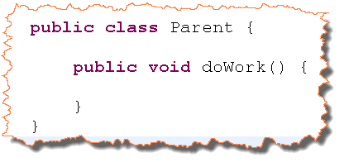
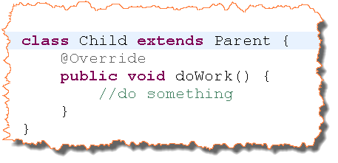
Annotation Example

Slide 20
Exploring Core JUnit4
Test class:
  Must be public
  Must contain a zero-argument constructor. Java creates this implicitly if the class does not define any other constructor.
Test method:
  Must be public
  Must be annotated with @Test
  Can have any name
  Should not take any arguments
  Must return void
Important annotations of JUnit 4
  @Test
  @Before
  @After
  @BeforeClass
  @AfterClass
  @RunWith
  @SuiteClasses

Slide 21
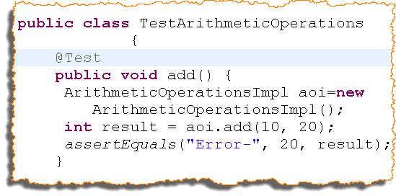
@Test annotation
Used to declare that a method is test method
A test case no more need to extend TestCase
Method name can be anything
Important attributes
  timeout – declares that the method should time out after given timeout value
  expected-declares that this method can throw exception

Slide 22
Exercise
Rewrite CalculatorTest class using Junit 4.

Slide 23
Assertions
JUnit Assert class provides a set of static assert methods to perform test validation.
Each assert method compares the expected and actual outcome to check failure or success of a test.
An error message is thrown if the expected and actual value do not match and test method terminates.
Each assert method is overloaded with an additional parameter – message. It is a best practice to provide an error message for all your assert method calls.

Slide 24
Assert methods
assertXXX method | What it’s used for
assertArrayEquals(“message”, A, B) | Asserts the equality of the A and B arrays.
assertEquals(“message”, A, B) | Asserts the equality of objects A and B. This assert invokes the equals() method on the first object against the second.
assertSame(“message”, A, B) | Asserts that the A and B objects are the same object. Whereas the previous assert method checks to see that A and B have the same value (using the equals method), the assertSame method checks to see if the A and B objects are one and the same object (using the == operator).
assertTrue(“message”, A) | Asserts that the A condition is true.
assertFalse(“message”, A) | Asserts that the A condition is false.
assertNotNull("message", A) | Asserts that the A object is not null.
assertNull(“message”, A) | Asserts that the A object is null.

Slide 25
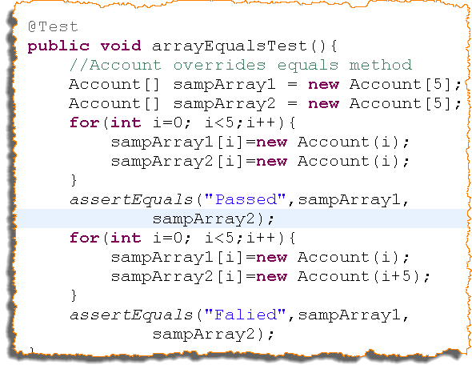
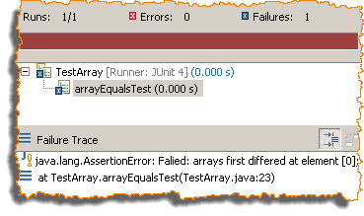
Assert methods ….. contd
New assertion methods to compare arrays
Individual elements of the arrays are compared using equals method
public static void assertEquals(Object[] expected, Object[] actual)
public static void assertEquals(String message, Object[] expected, Object[] actual)

Slide 26

Exercise
Write Employee class with following fields.
Id,name,salary,department,address
Write a Salary class with incrementSalary method.
Write JUnit test case for the following method of Salary class incrementSalary
Implement it as “SalaryJUnitTest”
Keep the file in “test” folder . The package structure of the file should be same as that of Salary class.

Slide 27
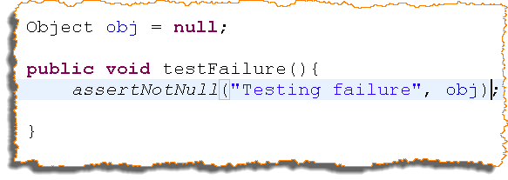
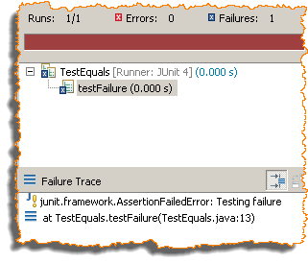
Errors vs. Failures
Two types of assertion messages
  Failures
  Errors
Failure
  JUnit failure
  It is the failure of assertion method
  Result is AssertionFailedError
  JUnit will display a message along with the expected and actual values whose comparison resulted in failure
  JUnit displays the line number of the assertion that caused the failure
  Will cause a test to fail

Slide 28
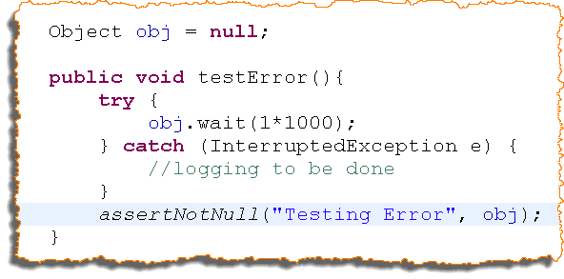
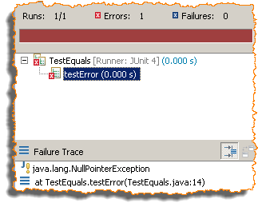
Errors vs. Failures (Contd..)
Errors
  Any uncaught subclass of Throwable will result in error
  JUnit provides exception stack trace
  JUnit provides the line number of error
  Will cause a test to fail

Slide 29
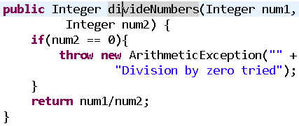
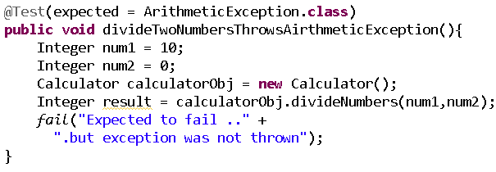
Testing for Exception and failures
JUnit has “fail” method to track failure.
Checked Exception thrown
  Use “expected” attribute of @Test annotation to handle exception
Checked Exception not thrown
  If a method is expected to throw exception for specific input and exception is not thrown then it’s failure of test.

Slide 30

Exercise
Write JUnit test case for the following method of Employee class - equals (Write this method if not already implemented)
Implement it as “EmployeeJUnitTest”
Example should demonstrate the difference between Error and Failure

Slide 31
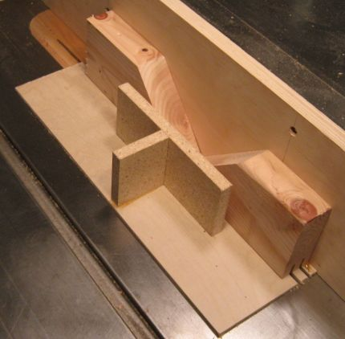
Test Fixtures
Methods for basic set up for running test.
They initialize fields, turn on logging, reset environment variables, close connection etc.
Method level fixtures - run for every test method.

Slide 32
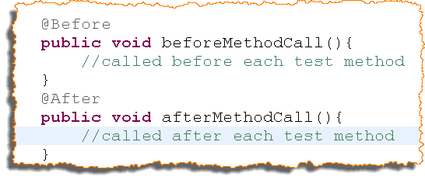
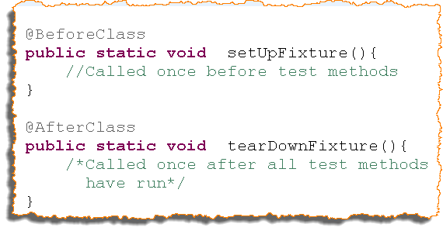
Annotations for Test Fixtures
@Before and @After
  The fixture methods can have any name
  Annotated methods should be public
  @Before annotated methods are executed right before any test method and is used for basic setup of the test method
  @After annotated methods are executed after any test method and is used for cleaning up regardless of whether the test failed or passes.
  You can have as many of these methods as you want, but the order of their execution is not defined.
@BeforeClass and @AfterClass
  The fixture methods can have any name
  Annotated methods should be public and static
  @BeforeClass annotated methods are executed only once before any of the test methods.
  @AfterClass annotated methods are executed only once after all of the test methods.
  You can have as many of these methods as you want, and again the order of the execution is unspecified.

Slide 33

Exercise
Write JUnit test case for the following methods of Oven class
  bake
Use the following fixture methods
  @Before – To start the oven(calling constructor)
  @After – To switch off the oven.
There should be a method in JUnit which checks the checked exception condition successfully.

Slide 34
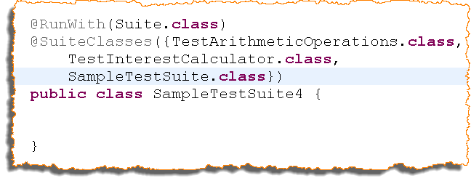
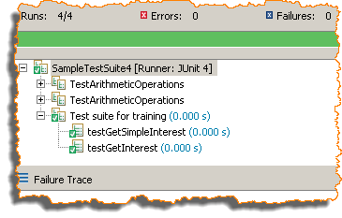
Test Suite
JUnit 4 provides annotation to run test suite
  @RunWith- declares that run current class as a test suite
  @SuiteClasses – defines the components of the suite

Slide 35
Exercise
Create a Test Suite using the tests for Calculator program and RetirementCalculator program.
Run the Test Suite.

Slide 36
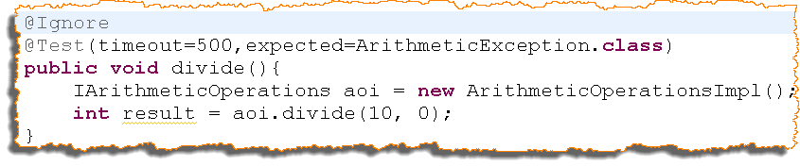

Timed Test and Ignored Test
Timed tests
  If a test method is taking very long time, a time out feature can be set
Ignored tests
  @Ignore annotation is used to ignore a test

Slide 37
Exercise
Refer to “Calculator Exercise” use ignore and timeout feature in that.

Slide 38
Exercise
Write an interface “PrimeFinder.java”. It has following methods
  public boolean findPrime(long number) throws ArithmeticException
    ArithmeticException is thrown if argument to the method is 0,1 or any negative integer
  public int findSquareRoot(int number) throws ArithmeticException
    ArithmeticException is thrown if the argument to the method is negative
Write its implementation class “PrimeFinderImpl.java”.
Test the “primeFinder” method for input 1234433444555551123 and findSquareRoot for 25.
You will observer that “findPrime” is taking lot of time but “findSquareRoot” method is executed.
Write a timeout and see if test is getting timed out.

Slide 39
Testing Strategies

Slide 40
Writing Testable Code
We discuss some best practices to improve your architecture and code so that the code is easily readable and testable. It is always easier to write easily testable code than it is to refactor existing code to make it easily testable.
Public APIs are contracts
  Most calls are made to public APIs. If you change the signature of a public method, then you need to change every call site in the application and unit tests. It is important to test all public methods so that if the API changes, it is easy to detect the runtime failure.
Reduce dependencies
  Unit tests verify your code in isolation
  In order to write testable code, you should reduce dependencies as much as possible.
  A solution to reducing dependencies is to separate your code between methods that instantiate new objects (factories) and methods that provide your application logic. We will look at an example in the next slide.
Follow the Principle of Least Knowledge
  This is a design guideline that states that one class should know only as much as it needs to know. We will look at an example in a later slide.
Favor composition over inheritance
  Composition can be easier to test. At runtime, code cannot change an inheritance hierarchy, but we can compose objects differently.
  The code should be as flexible as possible at runtime, so that it is easy to switch from one state of the object to another, and that makes the code easily testable.

Slide 41
Reduce Dependencies
Consider the example on the right.
  Every time we instantiate the Vehicle object, we also instantiate the Driver object. We have mixed the concepts.
  The solution would be to have the Driver interface passed to the Vehicle class as illustrated on the right.
    This allows us to produce a mock Driver object and pass it to the Vehicle class on instantiation. We can even mock any other type of Driver implementation - JuniorDriver, SeniorDriver, and so on - and pass it to the Vehicle class.
  Reduce dependencies
  class Vehicle {
  Driver d = new Driver();
  boolean hasDriver = true;
  private void setHasDriver(boolean hasDriver) {
  this.hasDriver = hasDriver;
  }
  }
  Pass the Driver to the Vehicle
  class Vehicle {
  Driver d;
  boolean hasDriver = true;
  Vehicle(Driver d) {
  this.d = d;
  }
  private void setHasDriver(boolean hasDriver) {
  this.hasDriver = hasDriver;
  }
  }

Slide 42
Principle of Least Knowledge
Consider the example on the right.
  We pass to the Car constructor a Context object. This is a violation of Principle of Least Knowledge, because the Car class needs to know that the Context object has a getDriver method. If we want to test this constructor, we need to get hold of a valid Context object before calling the constructor.
The proper solution is to apply the Principle of Least Knowledge and pass references to methods and constructors only when we need to do so. In our example, we should pass the Driver to the Car constructor.
Violating the Principle of Least Knowledge
class Car {
private Driver driver;
Car(Context context) {
this.driver = context.getDriver();
}
}
Pass the Driver to the Car
Car(Driver driver) {
this.driver = driver;
}

Slide 43
Testing in Isolation
For applications that depend on a specific runtime environment, writing unit tests is a challenge.
Your tests need to be stable, and when run repeatedly, they need to yield the same results. For this you need a way to control the environment in which the tests run.
One solution is to set up the real environment as part of the tests and run the tests from within the environment. But this is not always feasible.
The other solution is to simulate the missing part by replacing it with a fake that behaves the same way.
There are two strategies for providing the fake objects: stubbing and using mock objects.

Slide 44
Introducing stubs
A stub is a piece of code that’s inserted at runtime in place of the real code, in order to isolate the caller from the real implementation. The intent is to replace a complex behavior with a simpler one that allows independent testing of some part of the real code.
Following are the some examples when you may use stubs
  When you can’t modify an existing system because it’s too complex and fragile
  For coarse-grained testing, such as integration testing between different subsystems
Stubs usually provide high confidence in the tested system. With stubs, you aren’t modifying the objects under test, and what you are testing is the same as what will execute in production.
Cons of Stubs
  Stubs are often complex to write and need debugging themselves.
  Stubs can be difficult to maintain because they’re complex.
  Stubs don’t lend themselves well to fine-grained unit testing.
  Each situation requires a different stubbing strategy.

Slide 45
Testing with mock objects
Mock objects (or mocks for short) are an important tool for testing a portion of code logic in isolation from the rest of the code.
Mocks replace the objects with which your methods under test collaborate, offering a layer of isolation.
Mock objects are different from stubs because mocks don’t implement any logic, they are empty shells that provide methods to let the tests control the behavior of all the business methods of the faked objects.

Slide 46
Mock objects
Mock objects have the same interface as the real objects they mimic, allowing a client object to remain unaware of whether it is using a real object or a mock object.
Mocking frameworks allow the programmer to specify which, and in what order, methods will be invoked on a mock object and what parameters will be passed to them, as well as what values will be returned.
Some of the common mocking frameworks are Mockito, JMock, EasyMock.

Slide 47
Introduction - Mockito
Mocks concrete classes as well as interfaces
Little annotation syntax - @Mock
Verification errors are clean - click on stack trace to see failed verification in test; click on exception's cause to navigate to actual interaction in code. Stack trace is always clean.
Allows flexible verification in order (e.g: verify in order what you want, not every single interaction)
Supports exact-number-of-times and at-least-once verification
Flexible verification or stubbing using argument matchers (anyObject(), anyString() or refEq() for reflection-based equality matching)
Allows creating custom argument matchers or using existing hamcrest matchers

Slide 48
Demo - Mocking
Write a HeatEngine class that returns the heat status of a city based on its temperature.
Following are the classes:
  City – contains its temperature
  HeatEngine– uses City’s Temperature and returns HeatStatus(H/M/L) for defined temperature ranges
  Assume City is not yet ready but interface is available. Mock the City class using Mockito and write tests for the HeatEngine class.
Notes:
The facilitator should demo this example. Code for the same is checked in to the repository.

Slide 49
Exercise - Mocking
Implement a simple bank account program.
The use case is as follows: the user should be able to make a bank transfer from one account to another.
You should mock the domain object and not implement the database interaction using JDBC.

Slide 50
Test Driven Development

Slide 51
Being Test driven
Test-driven development (TDD) is development and design technique that helps us build the system incrementally, knowing that we are never far from a working baseline.
Small, quick steps are taken by creating unit tests so that we always create tested code.
TDD approach favors short development cycle that helps write high quality code from the start.
Conventionally we design first, then implement the design, and then test the implementation somehow – usually not too thoroughly.
TDD turns this thinking around and says we should write the test first and only then write code to reach that clear goal. Design is what we do last .
We look at the code we have and find the simplest design possible. This last step in the cycle is called refactoring. Refactoring is a disciplined way of transforming code from one state or structure to another, removing duplication and moving from specific code to more generic code.

Slide 52
Development Cycle
Traditional:
Test Driven Development:
TDD turns around the traditional design-code-test sequence. Instead, we test first, then write code, and design afterward.
Design
Code
Test
Test
Code
Design

Slide 53
TDD cycle
Test-Code-Refactor cycle of TDD:
Begin the TDD cycle by writing a test, it fails. It fails because the system does not have the functionality that it should have.
In the second step, we implement the missing functionality so that the test passes.
The last step is about transforming the current design towards a better design – refactoring.
The above cycle is also called red-green-refactor because a failed test is indicated by a red bar and when the test passes, the red bar turns to green.
Test
Code
Refactor

Slide 54
The heartbeat
TDD or Test driven development is based on a very simple rule:
Only ever write code to fix a failing test.
Write the test first, and only then write just enough code that makes it pass.

Slide 55
The Three Laws of TDD
You are not allowed to write any production code until you have first written a failing unit test.
You are not allowed to write more of a unit test than is sufficient to fail—and not compiling is failing.
You are not allowed to write more production code that is sufficient to pass the currently failing unit test.

Slide 56
TDD cycle in detail
First write a test
  When we write a write a test, we are really doing more than just writing a test.
  We are making design decisions. We are designing the API - the interface for accessing the functionality we are testing.
  By writing the test before the code it is testing, we are forcing ourselves to think hard about how we want the code to be used.
  Then write just enough code.
    Write just enough code to make the test pass
    Why just enough code? The test we have written is a test that is failing. It is pointing out a gap between what the code does and what we expect it to do. It is a small gap, which we should be able to close in a few minutes, so that the code is never broken for long.
And then refactor
  Take a step back, look at the design and figure out ways of making it better.
  By refactoring we remove the ugliness of the previously tested code.
Repeat
  Repeat the above cycle to develop software in small increments.

Slide 57
Test driven development – How?
Teams must be disciplined about ensuring that unit tests are written first, fully automated, and integrated into a regression suite
  Hold each other accountable. Focus on unit test coverage during code reviews, while integrating with code written by other team members or while helping team members in debugging
  Process champions and SME’s within the team
  Monitor reports e.g. code coverage, continuous integration build results
Teams must identify and standardize on unit testing tools/frameworks
Selected unit testing tools must support automation and integration with common build tools

Slide 58
Test driven development - Benefits
Certainty
  If you adopt TDD as a professional discipline, then you will write dozens of tests every day, hundreds of tests every week, and thousands of tests every year. And you will keep all those tests on hand and run them any time you make any changes to the code.
  This becomes more important when your codebase gets bigger. Whenever you make a change to any part of the code, you simply run the unit tests. If they pass, you can be nearly certain that the change you made didn’t break anything. How certain is “nearly certain”? Certain enough to ship!

Slide 59
Test driven development - Benefits
Reduced Defect Injection Rate
  When you use TDD, you ship your application based on nothing but passing tests. When you make changes to the code, and the existing and new tests pass, you know that you have not introduced defects on the way. The defect injection rate is very low.
  There have been several reports and studies that describe significant defect reduction. From IBM, to Microsoft, company after company and team after team have experienced defect reductions of 2X, 5X, and even 10X. These are numbers that no professional should ignore.

Slide 60
Test driven development - Benefits
Courage
This is one of the most powerful benefits of TDD. When you have a suite of tests that you trust, then you lose all fear of making changes. When you see bad code, you simply clean it on the spot.
When programmers lose the fear of cleaning, they clean! And clean code is easier to understand, easier to change, and easier to extend.
Notes:
Why don’t you fix bad code when you see it? Your first reaction upon seeing a messy function is “This is a mess, it needs to be cleaned.” Your second reaction is “I’m not touching it!” Why? Because you know that if you touch it you risk breaking it; and if you break it, it becomes yours.
But what if you could be sure that your cleaning did not break anything? What if you had the kind of certainty that I just mentioned? What if you could click a button and know within 90 seconds that your changes had broken nothing and had only done good?

Slide 61
Test driven development - Benefits
Improved Productivity
Incremental approach reduces debug time
Notes:
Improved productivity – Lesser debug time for developers as they take smaller steps (if something worked 30 minutes ago and is not working now it is much easier to locate where the problem is versus coding for several days without even compiling or testing), safety net promotes more creativity and improves morale as developers strive to improve their code without the fear of breaking.

Slide 62
Test driven development - Benefits
Documentation
The unit tests are documents. They describe the lowest-level design of the system. They are unambiguous, accurate, written in a language that the audience understands, and are so formal that they execute. They are the best kind of low-level documentation that can exist.
Notes:
Each of the unit tests you write is an example, written in code, describing how the system should be used. If you follow the law of TDD, then there will be a unit test that describes how to create every object in the system, every way that those objects can be created. There will be a unit test that describes how to call every function in the system every way that those functions can meaningfully be called. For anything you need to know how to do, there will be a unit test that describes it in detail.

Slide 63
Test driven development - Benefits
Improved Design
When you write tests for your code, you have to isolate that code. It is often difficult to test a method if that method calls other methods. To write that test you’ve got to figure out some way to decouple the function from all the others. In other words, the need to test first forces you to think about good design.
Notes:
If you don’t write your tests first, there is no force preventing you from coupling the functions together into an untestable mass. If you write your tests later, you may be able to test the inputs and the outputs of the total mass, but it will probably be quite difficult to test the individual functions.
Therefore, following the three laws, and writing your tests first, creates a force that drives you to a better decoupled design.

Slide 64
I can write my tests later…
No, you can’t. Not really. Oh, you can write some tests later. You can even approach high coverage later if you are careful to measure it.
The tests you write after the fact are defense. The tests you write first are offense. After-the-fact tests are written by someone who is already vested in the code and already knows how the problem was solved. There is just no way those tests can be anywhere near as incisive as tests written first.

Slide 65
Test driven development - Video
Lets watch a video to see how TDD is put in practice, listen and watch carefully
http://vimeo.com/album/205252

Slide 66
Code Coverage
Code coverage analysis is the process of:
Finding areas of a program not exercised by a set of test cases,
Creating additional test cases to increase coverage, and
Determining a quantitative measure of code coverage, which is an indirect measure of quality.
An optional aspect of code coverage analysis is:
Identifying redundant test cases that do not increase coverage.
A code coverage analyzer automates this process.
Notes:
Code coverage analysis is sometimes called test coverage analysis. The two terms are synonymous.

Slide 67
Code Coverage Tool - EclEmma
EclEmma is a free Java code coverage tool for Eclipse. It brings code coverage analysis directly into the Eclipse workbench.
Installation Instructions:
In ‘Eclipse Market Place’ tab of eclipse, find for ecobertura. Select the ecobertura product and follow the eclipse instructions for installation.
Restart the eclipse when installation is done.
Usage:
Right click on any Junit test, it will show the option ‘Coverage As’. Select the ‘Coverage As, Junit Test’ option.
Coverage Report is generated that can be viewed in coverage session window.
The coverage report generated shows the following:
  Line coverage,
  Branch Coverage and
  Total Coverage of code.
The part of the source code covered by the tool is green in color and the uncovered part of code will be red in color.

Slide 68
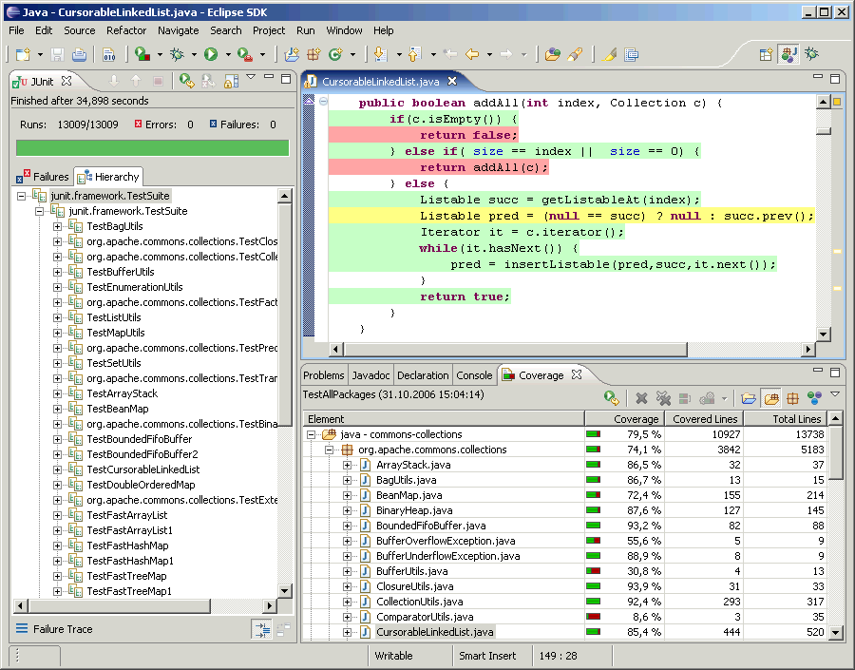
EclEmma – Code Coverage

Slide 69
TDD Demo
Use Test driven development to write a program to calculate the tax of an employee. Following are the specifications:
The program should take as input: monthly salary and age.
The output will be the tax that the employee should be paying.
The inputs will be whole numbers; however the resulting tax calculation may be a floating-point number.
If the employee is aged 50 or over, their taxable income reduces by 10%.
Taxation Rates are as follows:
The program should perform the following validations:
If negative income or age are input, throw InvalidInputException
Monthly Salary | Tax Rate
Rs. 0 - Rs 10,000 | No Tax
Rs. 10,001 - Rs. 50,000 | 10% of salary
Rs. 50,0001 - Rs. 1,00,000 | 15% of salary
> Rs. 1,00,000 | 20% of salary
Notes:
If facilitator is comfortable, he/she can do a demo for above and show the code coverage as well.

Slide 70
Exercise
Use Test driven development to write a program that, given three integers representing the length of the sides of a triangle, returns:
1 if the triangle is equilateral (all sides equal)
2 if the triangle is isosceles (2 sides equal)
3 if the triangle is scalene ( no sides equal)
And throw an exception if the triangle is not well formed. Triangle is considered not well formed if the sum of 2 sides is less than or equal to the length of third side.

Slide 71
Quiz
No code is checked-in unless it has an associated unit test and 100% of systems current set of unit tests are passing. True or false?
  True
The test code you write is determined by what system code you have written. True or false?
False. Tests determine what system code you need to write
You start with a failing test case then implement the entire functionality followed by writing the missing tests. True or false?
  False. Implement only enough to make the test pass
TDD is only applicable when implementing new features and not during bug fixing. True of false?
  False. Reproduce the bug by implementing a test case which would work if the bug is fixed. Make the code changes to fix the bug and subsequently the test case.
Unit tests are written after code is stable as it is easier to write and maintain. True of false?
  False

Slide 72

Questions

Slide 73

Assignment
Write JUnit test case for the following methods of EmployeeDetailsTest class
  displayTable
  diplayCount
EmployeeDetailsTest class is used in java101-Day4.
Implement it as “EmployeeDetailsJUnit4Test ”
Write class level fixture methods using Junit4 features for creating and closing connection.

Slide 74

Let us revise
Quality is the conformance to requirements.
Testing is to check for the quality.
Non conformance to the requirements is bug.
Bugs are costly so testing is very important.
Unit testing is performed by the developer at function level to check implementation
JUnit is a open source framework for writing and running unit test.
Test case is a class that extends from junit.framework.TestCase. It contains test methods to test.
Name of the test method should start with "test" for JUnit 3 and should be annotated with @Test for JUnit 4.

Slide 75
Let us revise
With JUnit 4,@RunWith and @SuiteClasses annotations provide infrastructure for test suite.
Timed tests (timeout attribute of @Test) and ignored test (@Ignore) are very handy features of JUnit4.
If a method is annotated with @Test then that class should not extend junit.framework.TestCase.
JUnit follows test isolation principle. Execution of one test method does not affect the execution of other test methods.

Slide 76
Let us revise
Assertions helps in testing the output of a test. Some common assertions are assertTrue, assertSame, assertNull and assertEquals.
setUp and tearDown are JUnit 3 test fixture method. They run for each test methods.
@Before and @After are JUnit 4 test fixture infrastructure. They also helps in running fixture methods for each test method.
@BeforeClass and @AfterClass are JUnit 4 test fixture infrastructure at class level. They run for every TestCase.

Slide 77

Quiz
Quality is the __________ to the requirements.
  Conformance
Bug is the __________ to the requirements.
  non-conformance
JUnit is a framework for __________ testing
  Unit
JUnit is written by the developer/QA
  Developer
A test case class should extend __________
  TestCase
The name of a test method should start with “tes” word. T/F
  False
@Test is the feature of JUnit __________ 4

Slide 78
Quiz
__________ and __________ annotation is used for fixture
  @Before, @After
__________ attribute of __________ annotation is used to handle exception in JUnit 4
  Expected, @Test
__________ annotation is used to ignore the test
  @Ignore
“timeout” is the feature of JUnit __________(version)
  4
TestNG is used for unit testing. T/F
  False

Slide 79
Hands on Exercises

Slide 80
Exercise
Write a test class for RetirementCalculator implemented in Java101.
Write tests for all scenarios – success and failure
Notes:
Retirement Years Left Exercise:
Our company requires a software which finds out - The number of years left for a person to retire.
The program would be supplied with the year of birth of the employee.(the retirement age is 58 years) and will display the number of years left for active employment.
Include checks for year values. (The year shouldn’t be a negative integer and it shouldn’t be a year in the future, etc.).

Slide 81
Exercise
Write JUnit test cases for comparing the employee objects created.
Implement it as “EmployeeCmpJUnitTest”
Keep the file in “test” folder . The package structure of the file should be same as that of Salary class.
The JUnit should have two methods that demonstrate the following two asserts:
    assertTrue(comparing two new employee objects. This should fail)
    assertFalse(Comparing two new employee objects. This should pass)

Slide 82
Exercise
Write JUnit test cases for comparing the employee objects created.
Implement it as “EmployeeCmp2JUnit3Test”
Keep the file in “test” folder . The package structure of the file should be same as that of Salary class.
The JUnit should have two methods that demonstrate the following two asserts:
  assertSame(comparing two new employee objects. This should fail)
  assertEquals(Comparing two new employee objects. This should pass)

Slide 83

Exercise
Write a DBConnection class for getting the database connection.
Write a JUnit test case for testing of getConnection method of DBConnection class
Implement it as “DBConnectionJUnit4Test”.
Place the file in “test” folder . The package structure of the file should be same as that of DBConnection class.
The JUnit should have two methods that demonstrate the following two asserts:
  assertNull(Comparing Connection object is null. This should fail)
  assertNotNull(Comparing Connection object is not null. This should pass)

Slide 84
Exercise
Modify “DBConnectionJUnitTest” to add fixture methods
  @Before
    This method creates DB connection and stores it in a instance variable
  @After
    This method closes DB connection once the test case executes
Write test method to test the connection instance variable that checks whether it’s null or not

Slide 85
Exercise
Write a DBConnection class for getting the database connection.
Write a JUnit test case for testing of getConnection method of DBConnection class
Implement it as “DBConnectionJUnit3Test”.
Place the file in “test” folder . The package structure of the file should be same as that of DBConnection class.
The JUnit should have two methods that demonstrate the following two asserts:
  assertThat()

Slide 86
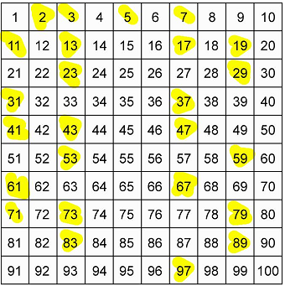
Exercise (Contd..)
Can you think of some feature of JUnit 4 that may be useful for testing “findPrime”?
As finding a prime number is a very time consuming process for very large integer. Set a timeout of 10s for this test method. Now test TestPrimeFinder4.java for input 12341

Slide 87
Exercise
Write a program that takes as input an integer and finds out if the number is odd or even.
Write a JUnit test as Parameterized test to execute the program on various input numbers.(For this you need to go through the parameterized testing in Self Study Section)

Slide 88
Exercise
When editing text files, like source code, one often happens to add spurious spaces and tabs in the end of each line. Instead of pressing the "End" key at each line and removing those invisible characters manually, a simple algorithm to remove them automatically at the press of a button could be used.
Using Test-Driven Development, build a program that, given an input string, produces a right-trimmed output string.

Slide 89
Exercise
Using test driven development, build a class that decomposes a given URL into its constituents. For example, http://www.google.com/mypage we would like to get the result
The protocol: "http"
The domain name: "www.google.se"
The path: “mypage”
Here are some example tests you could write to design this functionality:
"http://some.thing" should give protocol=="http"
"ftp://a.large.site" should give domain=="a.large.site"
"http://a.site.with/a-path" should give path=="a-path"

Slide 90
Exercise
In text editors you can usually find a configuration setting named "Word wrap". When checked, lines that do not fit horizontally in the editor window are "wrapped" to several lines, thus removing the need for a horizontal scroll bar in the window.
Using Test driven development, develop a word-wrapping algorithm, which is given a string and a row-length, and returns a list of word-wrapped-rows.
Examples of behavior:
If the row-length is 60, and the input string is 30, the result is just the input string
If the row-length is 3, and the input string is "abc def" the result is "abc", "def"
If the row-length is 3, and the input string is "abcdef" the result is "abc", "def"
If the row-length is 3, and the input string is "abcdef abc" the result is "abc", "def", "abc"
With row length 3 and "a b c d e f" the result is "a b", "c d", "e f"

Slide 91
Exercise
Use Test driven development to write a program to compute the Fibonacci series.

Slide 92
Thank You !

